Slide 1

Panther Press
Wednesday, September 11, 2024
Information Meeting 2024-2025

Slide 2


Table of Contents
1
2
3
Club Overview
Boards
Meetings

Slide 3

Club Overview
Panther Press is our school’s own newspaper!
A monthly newspaper featuring student voices

Slide 4


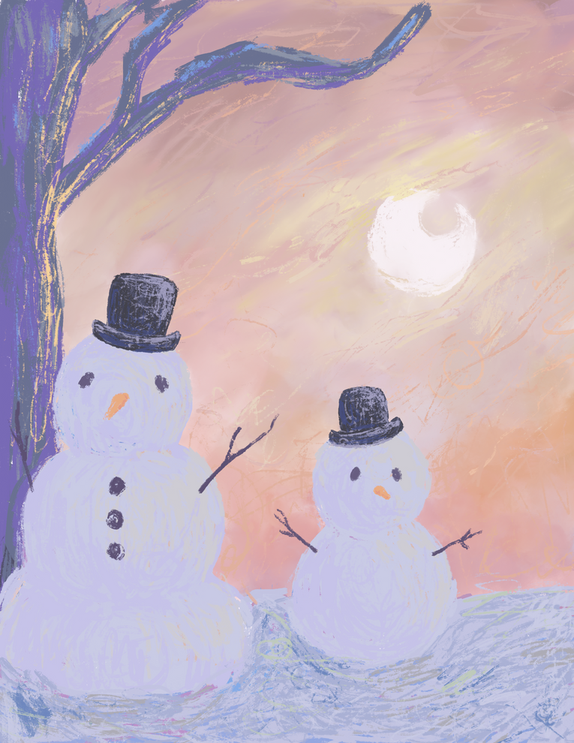
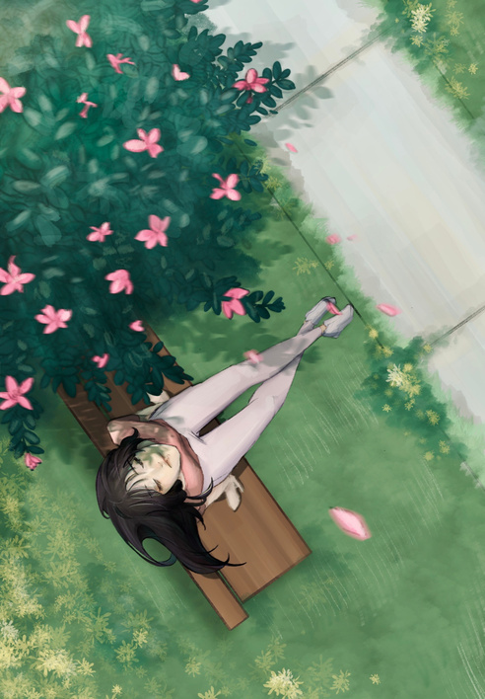
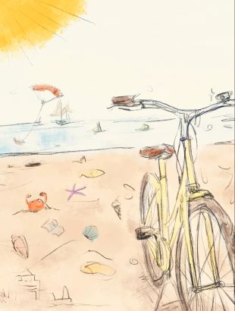
Previous Issues...
2023 november recap issue
2023 winter recap issue
Panther
Press
Panther
Press
Panther
Press
Panther Press
Panther
Press
October 2023
November 2023
Winter 2023-2024
2023/2024 Collection
2024 spring recap issue
Spring 2024
Summer 2024

Slide 5
Boards
1
2
3
News
Editorial
Life
4
5
6
Visual Arts
Print Development
Web Development

Slide 6

News Board
In charge of reporting events around the school and occasionally the world
Includes:
School events
School clubs
Interviews
Issues around the school

Slide 7
Editorial Board
In charge of writing about personal opinions on various topics
Includes:
Opinion pieces
Debates

Slide 8
Life Board
In charge of making creative pieces
Includes:
Stories
Poetry
Visual Arts pieces*
Anything creative!
*If you would like to make art pieces that go with other people’s written pieces, the Visual Arts Board may be better suited for you.

Slide 9
Visual Arts Board
In charge of making visual pieces to go with written works
Includes:
Photography
Drawings
Paintings
Anything creative!*
*If you would like to make art pieces that don’t go with other people’s written pieces, the Life Board may be better suited for you.

Slide 10
Print Development Board
In charge of creating the layout of the newspaper and putting everything together
Includes:
The cover
Theme of the newspaper
Setting written and visual works

